Slide 1
ATAI
Advanced Technique of Artificial Intelligence
ATAI
ChongqingUniversity _{AdvancedTechniqueof}
of Technology Artificial Intelligence
Chongqing University of
Technology
Chongqing University ^{ATAI}
_{of Technology} Advanced Techniqueof
Artificial Intelligence
Chongqing University of Technology
Chongqing University of Technology
Disentangled Contrastive Bundle Recommendation with Conditional Diffusion
Code : None
—— AAAI’2025
2025.5.15. • ChongQing
Reported by YaoYao Zhang
1

Slide 2
ATAI
Advanced Technique of Artificial Intelligence
ATAI
ChongqingUniversity _{AdvancedTechniqueof}
of Technology Artificial Intelligence
Chongqing University of
Technology
Chongqing University ^{ATAI}
_{of Technology} Advanced Techniqueof
Artificial Intelligence
Chongqing University of Technology
Chongqing University of Technology
Motivation
i)The dynamic nature of user preferences and interactions introduces noise that can distort the effectiveness of recommendations.
ii)In multi-view learning, previous methods directly fused representations from different views for contrastive learning, which may introduce semantic noise.

Slide 3
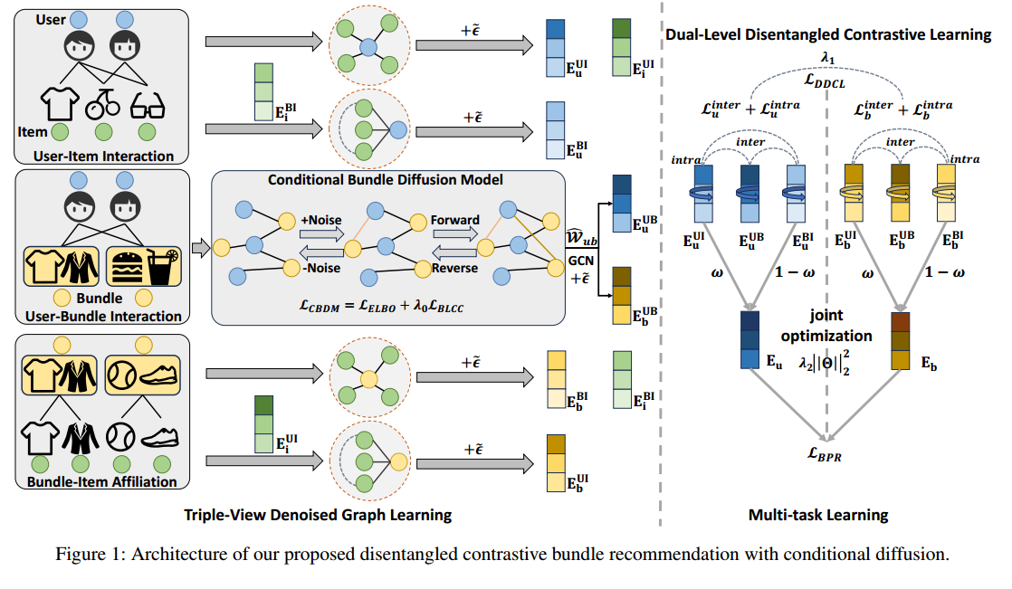
ATAI
Advanced Technique of Artificial Intelligence
ATAI
ChongqingUniversity _{AdvancedTechniqueof}
of Technology Artificial Intelligence
Chongqing University of
Technology
Chongqing University ^{ATAI}
_{of Technology} Advanced Techniqueof
Artificial Intelligence
Method
Chongqing University of Technology
Chongqing University of Technology

Slide 4
ATAI
Advanced Technique of Artificial Intelligence
ATAI
ChongqingUniversity _{AdvancedTechniqueof}
of Technology Artificial Intelligence
Chongqing University of
Technology
Chongqing University ^{ATAI}
_{of Technology} Advanced Techniqueof
Artificial Intelligence
Chongqing University of Technology
Chongqing University of Technology

Slide 5
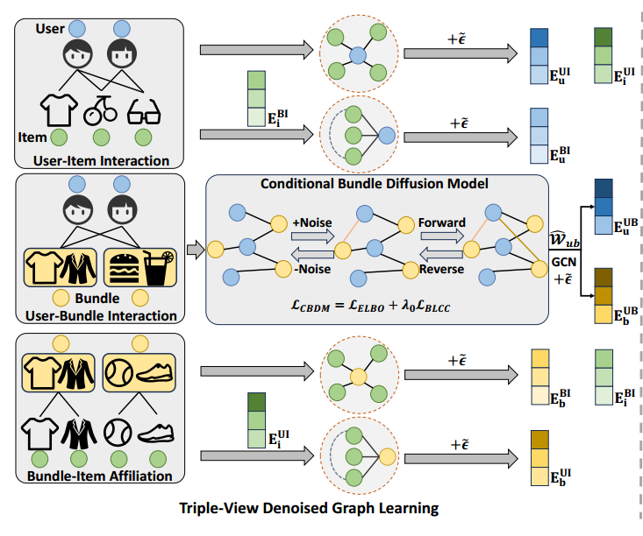
ATAI
Advanced Technique of Artificial Intelligence
ATAI
ChongqingUniversity _{AdvancedTechniqueof}
of Technology Artificial Intelligence
Chongqing University of
Technology
Chongqing University ^{ATAI}
_{of Technology} Advanced Techniqueof
Artificial Intelligence
Method
Chongqing University of Technology
Chongqing University of Technology
Notes:
(2)对一个用户所属的所有群组进行处理，让用户所属的每个群组乘以一个权重再相加得到

Slide 6
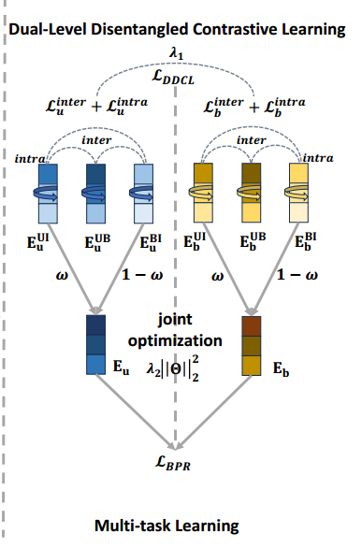
ATAI
Advanced Technique of Artificial Intelligence
ATAI
ChongqingUniversity _{AdvancedTechniqueof}
of Technology Artificial Intelligence
Chongqing University of
Technology
Chongqing University ^{ATAI}
_{of Technology} Advanced Techniqueof
Artificial Intelligence
Method
Chongqing University of Technology
Chongqing University of Technology

Slide 7
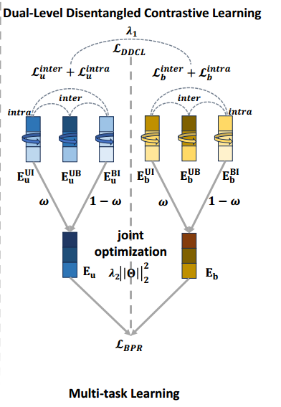
ATAI
Advanced Technique of Artificial Intelligence
ATAI
ChongqingUniversity _{AdvancedTechniqueof}
of Technology Artificial Intelligence
Chongqing University of
Technology
Chongqing University ^{ATAI}
_{of Technology} Advanced Techniqueof
Artificial Intelligence
Method
Chongqing University of Technology
Chongqing University of Technology
Notes:
(2)对一个用户所属的所有群组进行处理，让用户所属的每个群组乘以一个权重再相加得到

Slide 8
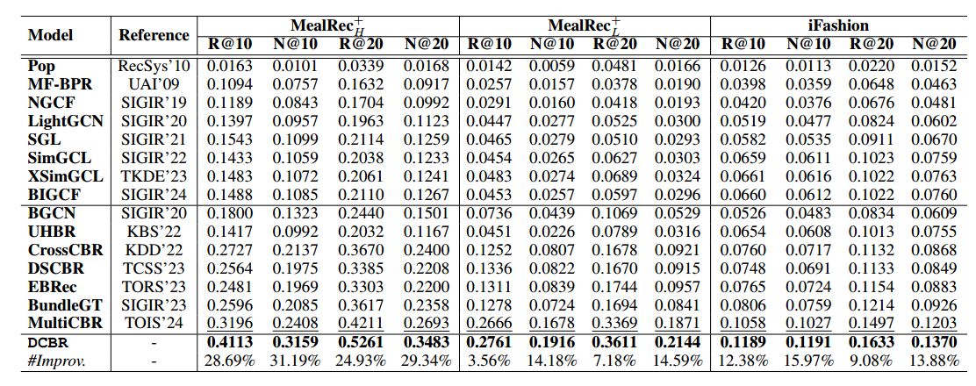
ATAI
Advanced Technique of Artificial Intelligence
ATAI
ChongqingUniversity _{AdvancedTechniqueof}
of Technology Artificial Intelligence
Chongqing University of
Technology
Chongqing University ^{ATAI}
_{of Technology} Advanced Techniqueof
Artificial Intelligence
Chongqing University of Technology
Experiments
Chongqing University of Technology

Slide 9
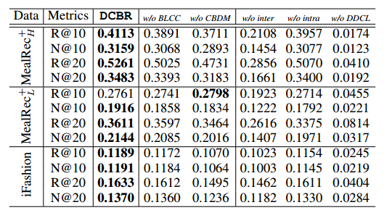
ATAI
Advanced Technique of Artificial Intelligence
ATAI
ChongqingUniversity _{AdvancedTechniqueof}
of Technology Artificial Intelligence
Chongqing University of
Technology
Chongqing University ^{ATAI}
_{of Technology} Advanced Techniqueof
Artificial Intelligence
Chongqing University of Technology
Chongqing University of Technology

Slide 10
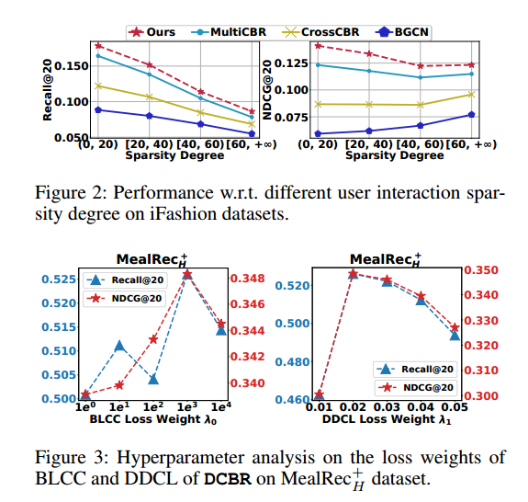
ATAI
Advanced Technique of Artificial Intelligence
ATAI
ChongqingUniversity _{AdvancedTechniqueof}
of Technology Artificial Intelligence
Chongqing University of
Technology
Chongqing University ^{ATAI}
_{of Technology} Advanced Techniqueof
Artificial Intelligence
Chongqing University of Technology
Chongqing University of Technology

Slide 11
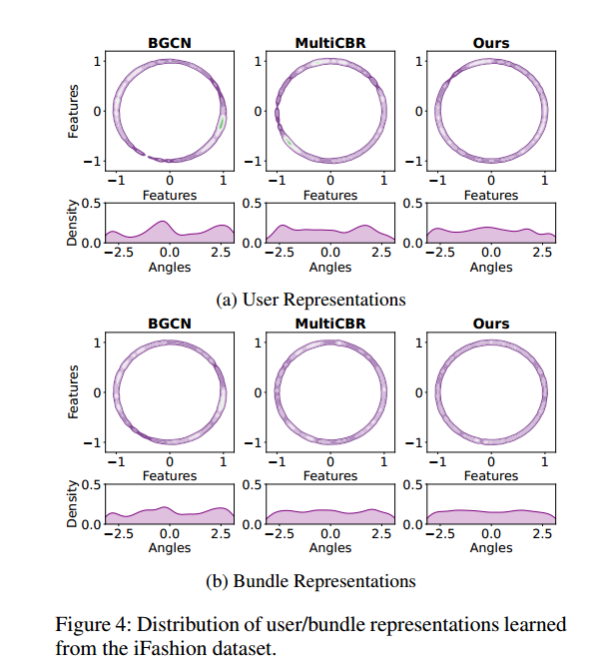
ATAI
Advanced Technique of Artificial Intelligence
ATAI
ChongqingUniversity _{AdvancedTechniqueof}
of Technology Artificial Intelligence
Chongqing University of
Technology
Chongqing University ^{ATAI}
_{of Technology} Advanced Techniqueof
Artificial Intelligence
Chongqing University of Technology
Chongqing University of Technology

Slide 12
ATAI
Advanced Technique of Artificial Intelligence
ATAI
ChongqingUniversity _{AdvancedTechniqueof}
of Technology Artificial Intelligence
Chongqing University of
Technology
Chongqing University ^{ATAI}
_{of Technology} Advanced Techniqueof
Artificial Intelligence
Chongqing University of Technology
Chongqing University of Technology
Thanks

